Slide 1
SPORTS BUDDY FINDER
BY Sports buddy team
Jialin Ding, Linda Namisi, Noor Monam, Pattiya Mahapasuthanon, Sergey Kompaniyets, Wesley Hancock

Slide 2
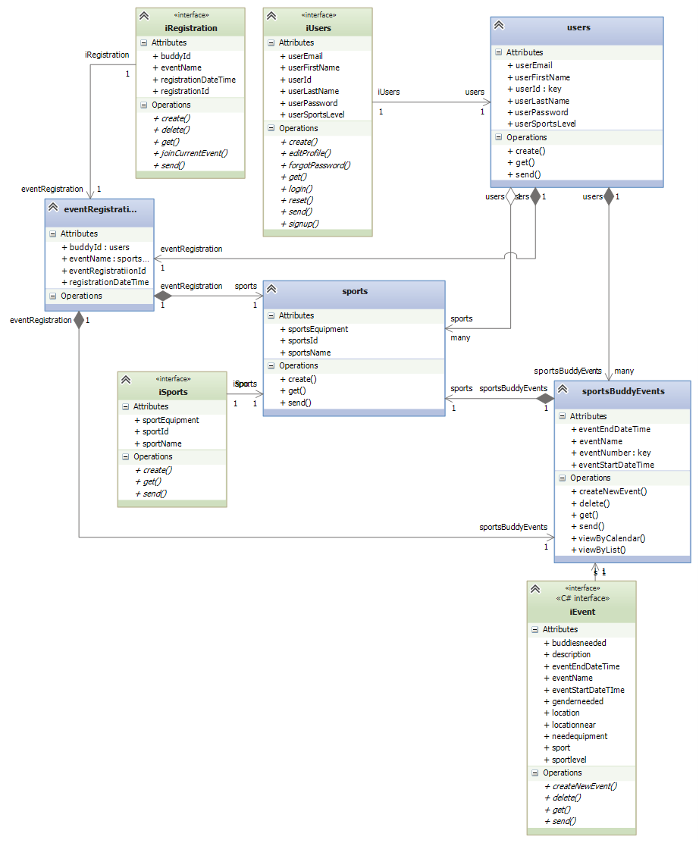
Original Class Diagram

Slide 3
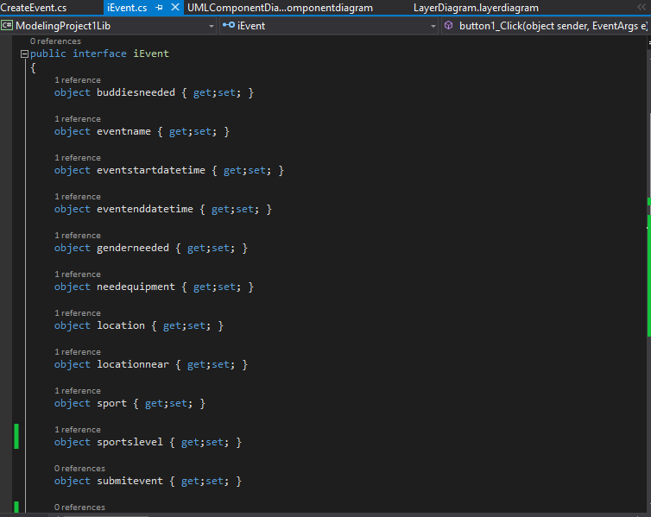
Generated code from class diagram

Slide 4
Our Code
Links to our original class diagram
C# windows form application
Reusable Objects from .NET framework
Linkages between window forms application and interfaces

Slide 5
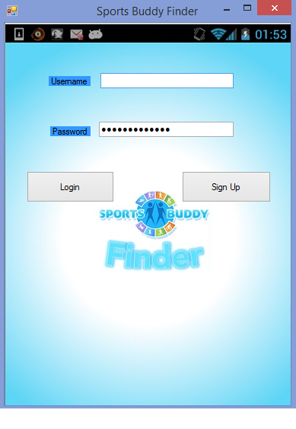
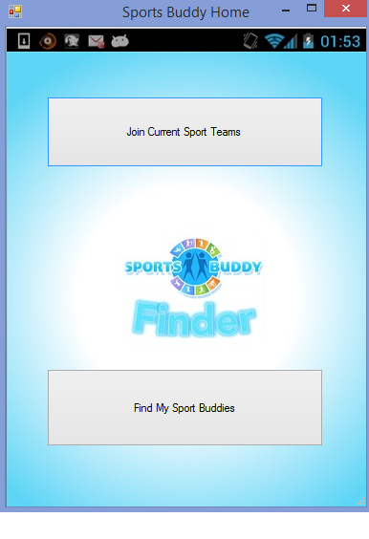
Demonstration of our application
Sports Buddy Home shows up
After login with user account!

Slide 6
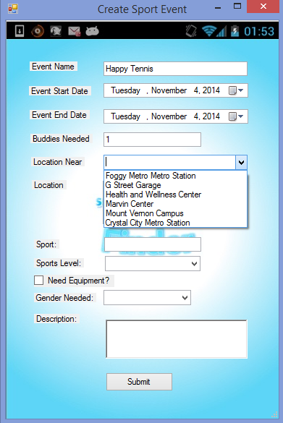
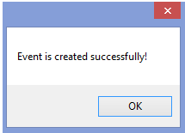
Create event after clicking find my sport buddies

Slide 7
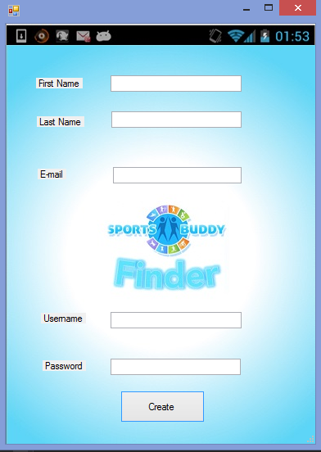
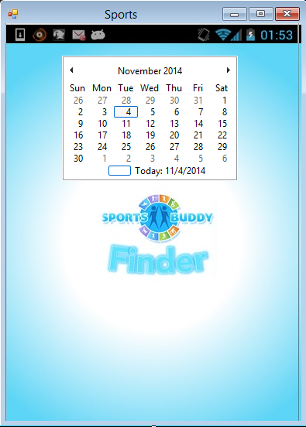
Crete user account and check available sport event

Slide 8
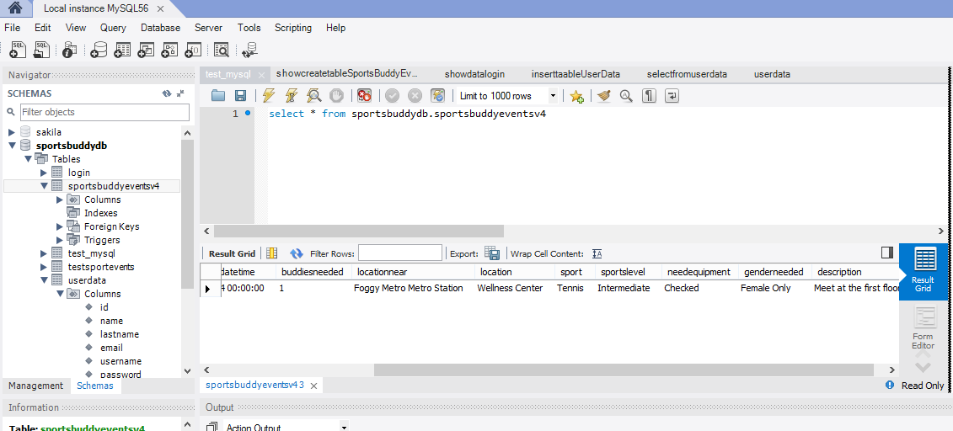
The event gets updated to our database
We queried sport events we created in our MySQL Database

Slide 9
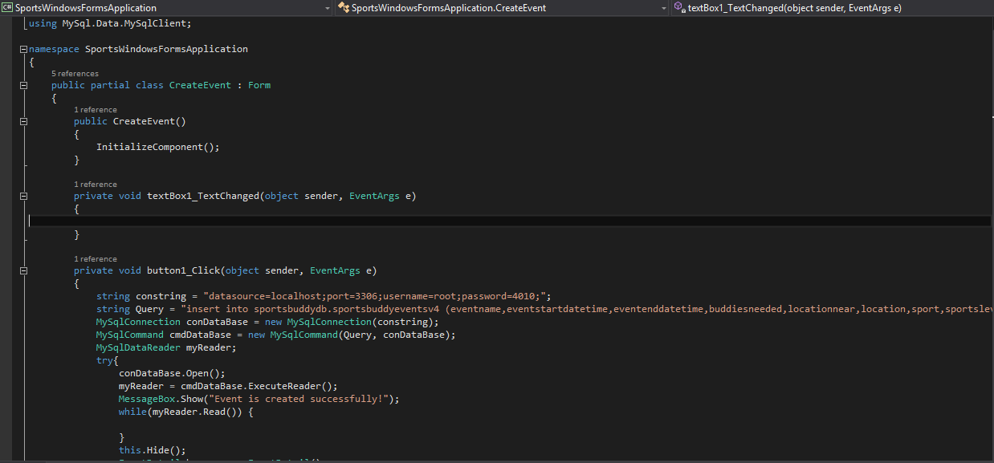
Code for create event page (1)

Slide 10
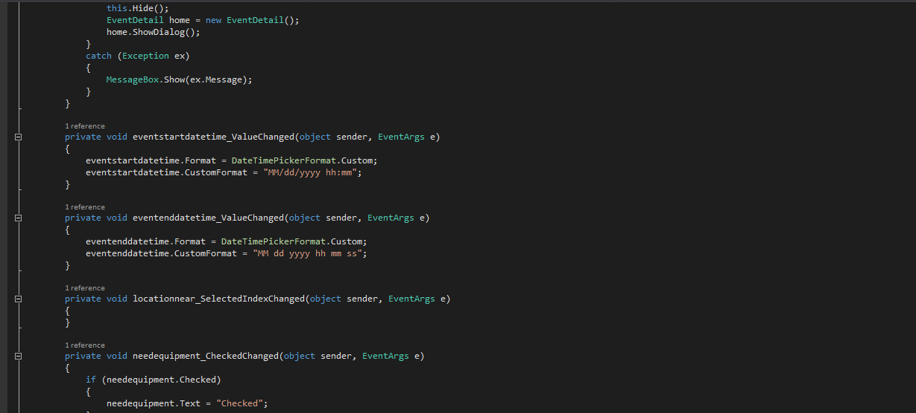
Code for create event page (2)

Slide 11
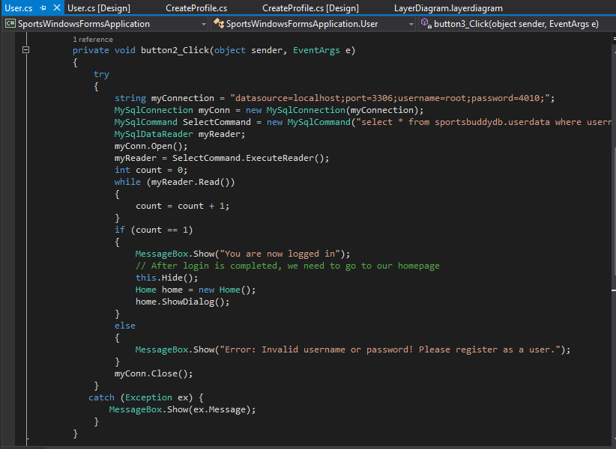
Code for login/home page

Slide 12
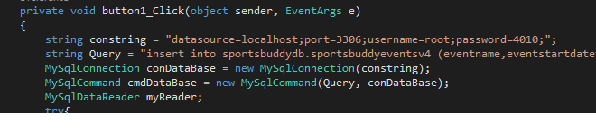
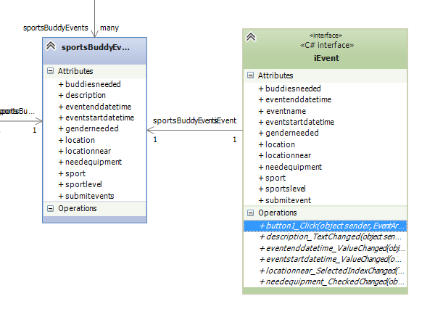
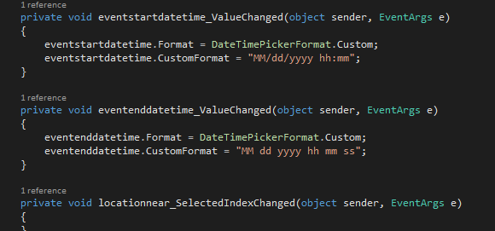
Comparison of code and class diagram
- Consistent methods from Class Diagram

Slide 13
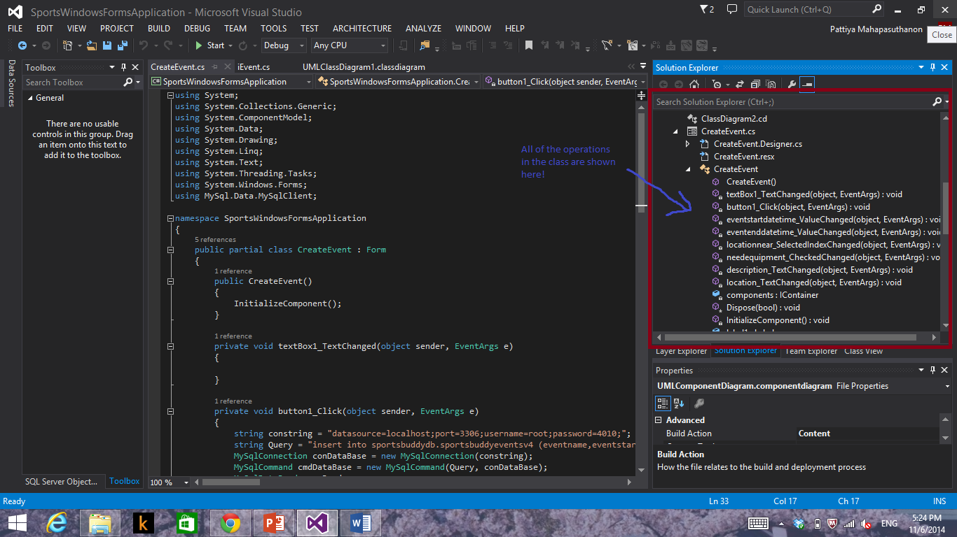
Our Solution Explorer shows methods for a particular class

Slide 14
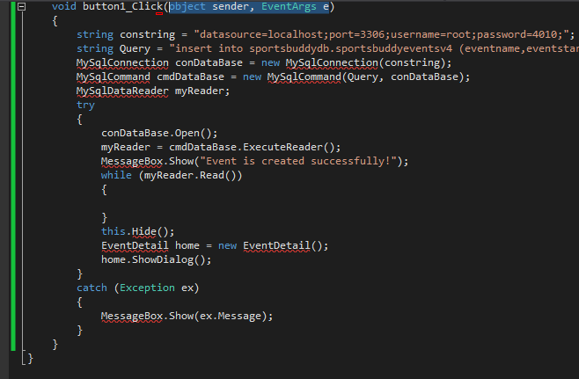
Methods are linked to our generated code
Click method in iEvent interface and it is linked to our generated code

Slide 15
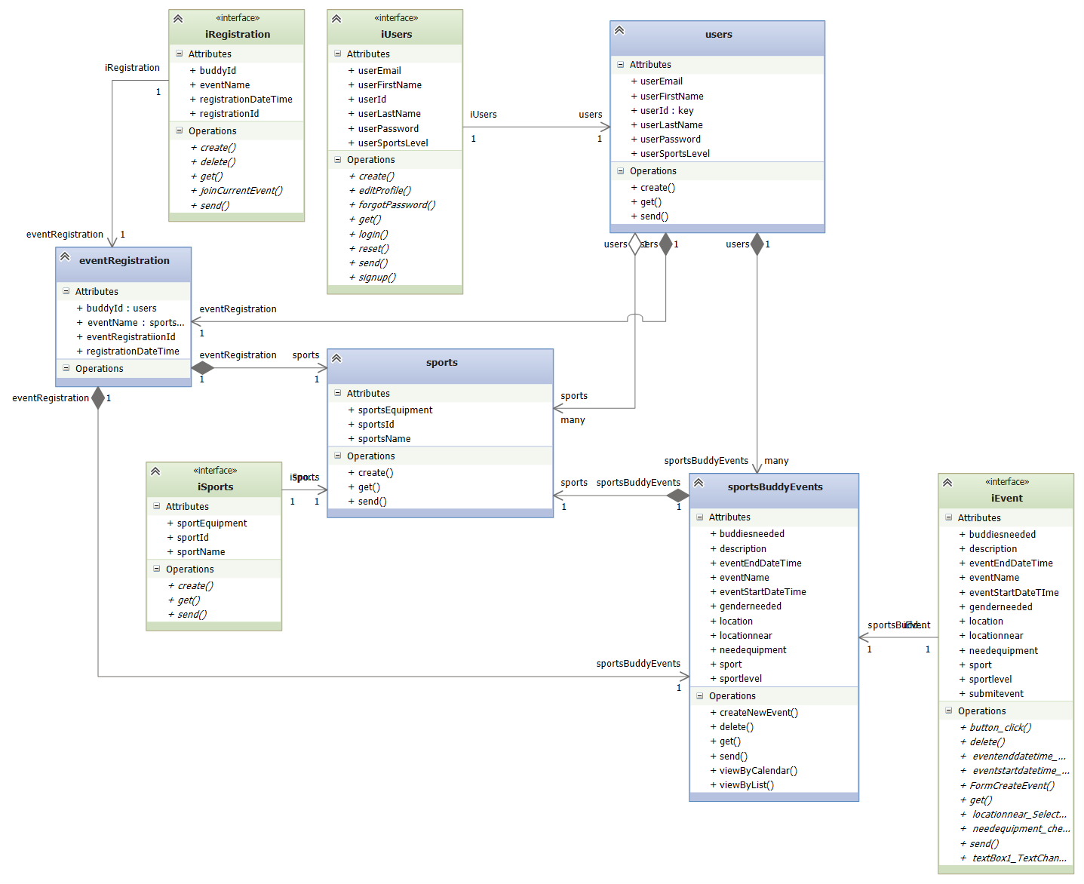
Updated Class diagram

Slide 16
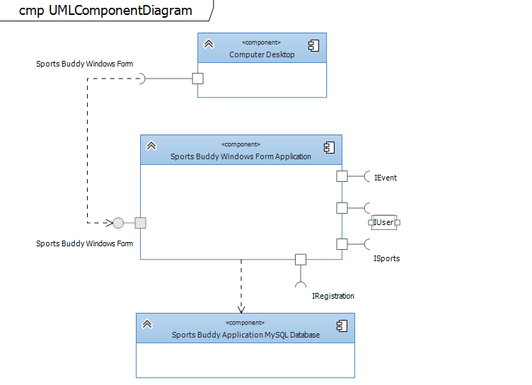
Component diagram

Slide 17
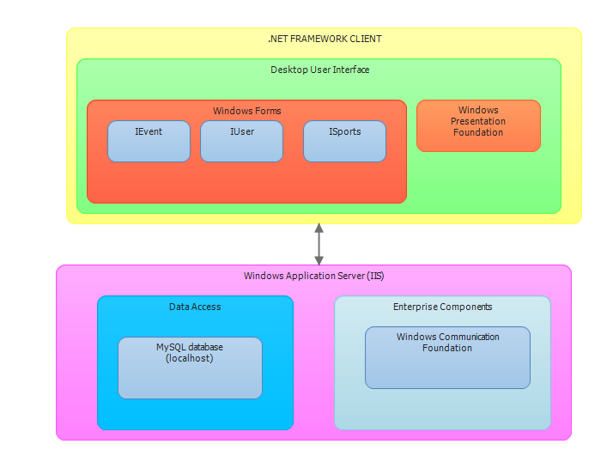
Layer diagram

Slide 18
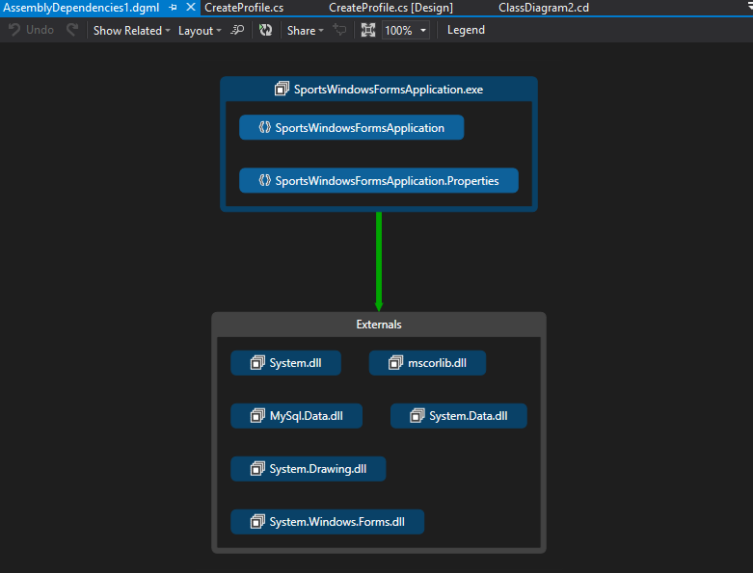
Dependency graph to express linkages

Slide 19
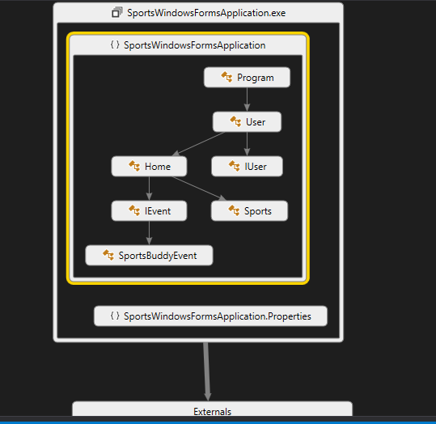
Dependency graph (2)
SportsWindowsFormsApplication.exe consists of 6 Classes and shows the linkages between each of them!

Slide 20
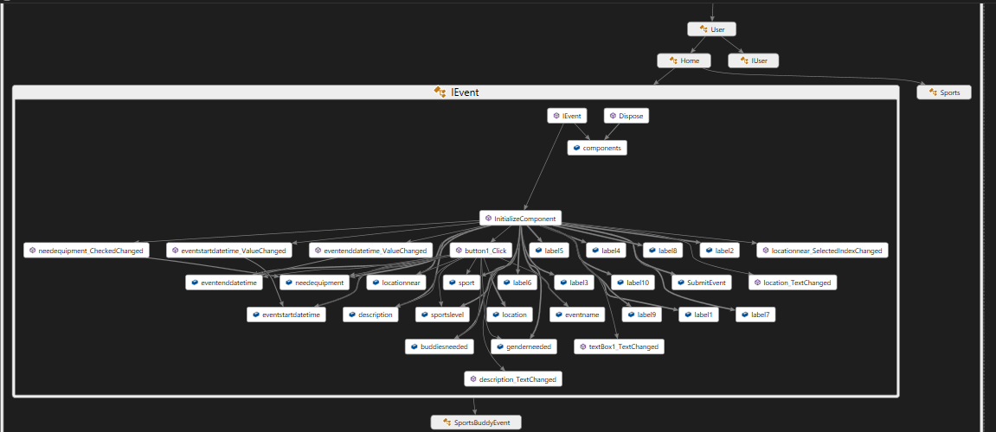
All dependencies are shown including methods and attributes

